Slide 1

Medcurity Network Inventory
Team
< Brandon Huyck >
< Colleen Lemak >
< Artis Nateephaisan >
< Jack Nealon >

Slide 2
Project Overview
Project Purpose:
Facilitate risk assessment for medical offices (keep patient data secure)
Software and device inventory is first step
Required by HIPAA
Goal is to generate through automation
Tasks for Tool:
Scan the network
Store the data
Display to user, and allow updates
Export to CSV for accessibility
Notes:
[Brandon] https://drive.google.com/file/d/1t3Uli4sEHQGK8-wLpj71EnXzGaBKhPuK/view
Goal: sponsor provides risk assessment for medical offices to help keep patient data secure; inventory is helpful in assessment and required by HIPAA; we develop a tool to automate the generation of this inventory.
Tasks: Scan the network; store the data; display to user and allow updates; export to excel for ease of accessibility (important to sponsor)
“Major Components”: Launch with bash, scan network, store info in db, display on ui, updatable through ui, export to excel with python

Slide 3
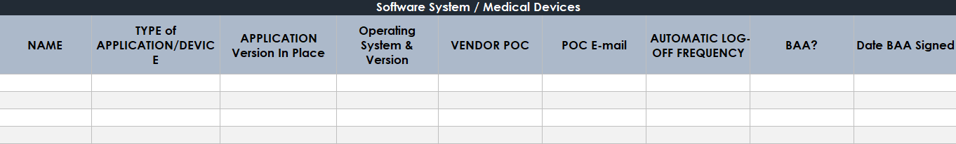
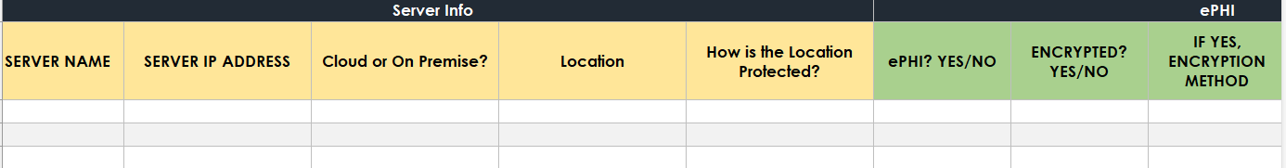
Excel Inventory Example
Notes:
Database → how being displayed in UI and exported → show how expanded into different relations

Slide 4
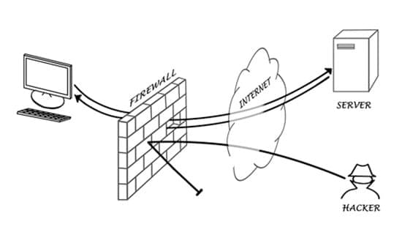
Considerations for the Crawl…
Requires authorization
Computers are wired to defend information!
Notes:
[Colleen]

Slide 5
Additional Work Accomplished
Database
Implements APIs for integration between scripts
Crawler
Python script retrieves data and pushes to DB through UI
Notes:
[Colleen, Brandon on DB]

Slide 6
Additional Work Accomplished
User-Interface:
PHP Homepage connects to DB
Login and Settings pages built-out
Export:
Implemented in Python
Launch through UI with PHP
Notes:
[Colleen]

Slide 7
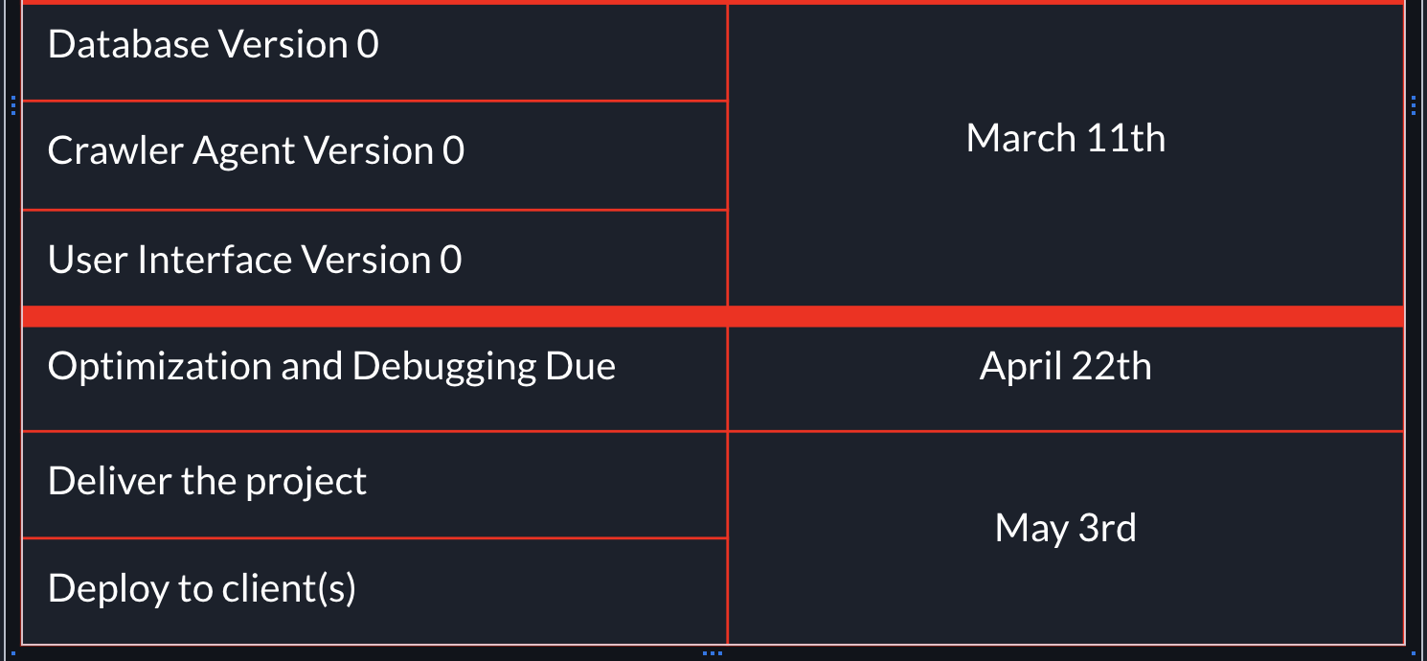
Comparative Timeline
Progressing well
Crawler, UI, DB Schema
Made some fixes and small edits
DB, Crawler, UI v0 complete/nearly complete
Gather info from testing events
Finalize components, then pursue optimization, debugging, testing, documentation, etc
Notes:
[Artis]
Need to edit the slides

Slide 8
Project Management and Team Collaboration
Two weekly meetings: one with advisor, DAB member/sponsors as needed, and one with just the development team
Team goes over GitHub backlog, each member provides updates on progress, and work is assigned for next sprint
Mainly coded separately, questions and issues brought up in meetings
Other questions or updates sent through texts, email, or Discord
Notes:
[Artis]
What approaches has your team agreed to use for running the project
Two weekly meetings: one with advisor, DAB member, sponsors as needed, one with just the development team
Pull requests are created and we typically assign one other team member to review and approve the request and merge
Every sprint (2 weeks) we have a different team member lead the meeting and go through our backlog to get progress updates and assign backlog tasks as needed
Let us know how your team will be collaborating to make this happen
Communicated through texts and Discord messages
Mainly coded separately but brought up issues and during meetings and got them promptly resolved

Slide 9
Does your project plan require budget resources?
Cloud Service System (AWS)
Medcurity is covering all AWS charges
Testing Devices
Raspberry pi, routers and switches
No additional expenses, and do not foresee any in the future
Budget Plan and Status
Notes:
[Jack]
Does your project plan require budget resources?
The main component that would require a budget was a cloud service system
Our sponsor had access to AWS, so we were set up the database needed for our project through that service
We were able to ask IT for a Raspberry Pi and we were able to gain access to a router used for testing our crawler
We have not used any budget and currently have no plans in doing so down the line

Slide 10


Updates to Project Risks and Delivery Issues
Risks:
Delivery:
Data Security Breach
Software Incompatibility
Credentials leak (update)
CS10 Github Repository
Export as .csv file
Notes:
[Colleen]

Slide 11
Demo

Slide 12
10/24-11/6 | 1/30 - 2/12
11/7 - 11/ 20 | 2/13 - 2/26
11/27 - 12/4 - Post Thanksgiving | 2/27 - 3/10 - Version 0 Complete
12/5 - 12/18 - Layouts + Outlines Done | 3/18 - 3/25 - Post Spring Break
12/19 - 1/1 - Winter Break | 3/26 - 4/8 Documentation, Testing, Poster Work
1/2 - 1/15 - Winter Break | 4/9 - 4/22 - Debug and Optimize Done
1/16 - 1/29 | 4/23 - 5/3 - Delivery and Deployment
Revised Project Release Plan
Notes:
[Jack]
Still aiming for a V0 completion deadline at March 10th.
Returning from Spring Break, we want to wrap up the documentation and testing
From 4/9 - 4/22 we address any issues that may have popped up during our testing.
And from 4/23 - 5/3 We look to wrap up delivery and deployment and hand over the repo to our sponsor.

Slide 13



Summary
Lots of progress:
Development flow:
Looking forward:
Solidified and tidied up Crawler and Database
UI connects with Database
Far along in final integration
Reëstablished schedules, meetings, and teamwork for new semester
Finalizing individual components and integration
Preparing for testing and sponsor acceptance
Presenting results and accomplishments
Notes:
[Brandon]
This is a short presentation (target is 15 minutes + 5-8 mins in questions)
Focus on what business objectives you’re now able to confidently address and what notable wins you’ve had through your alpha dev window since the project plan presentation
In summary, we’ve made lots of progress in initial development of each component of the project
Scanning collects an array of information
DB is set up; python api is set up
UI login page built, home page built, and more
We’ve gotten into a flow with teamwork, team meetings, development strategies, etc.
Most importantly, we have a clear picture of the work that needs to be accomplished in the second semester, and believe in our ability to do so

